Slide 1
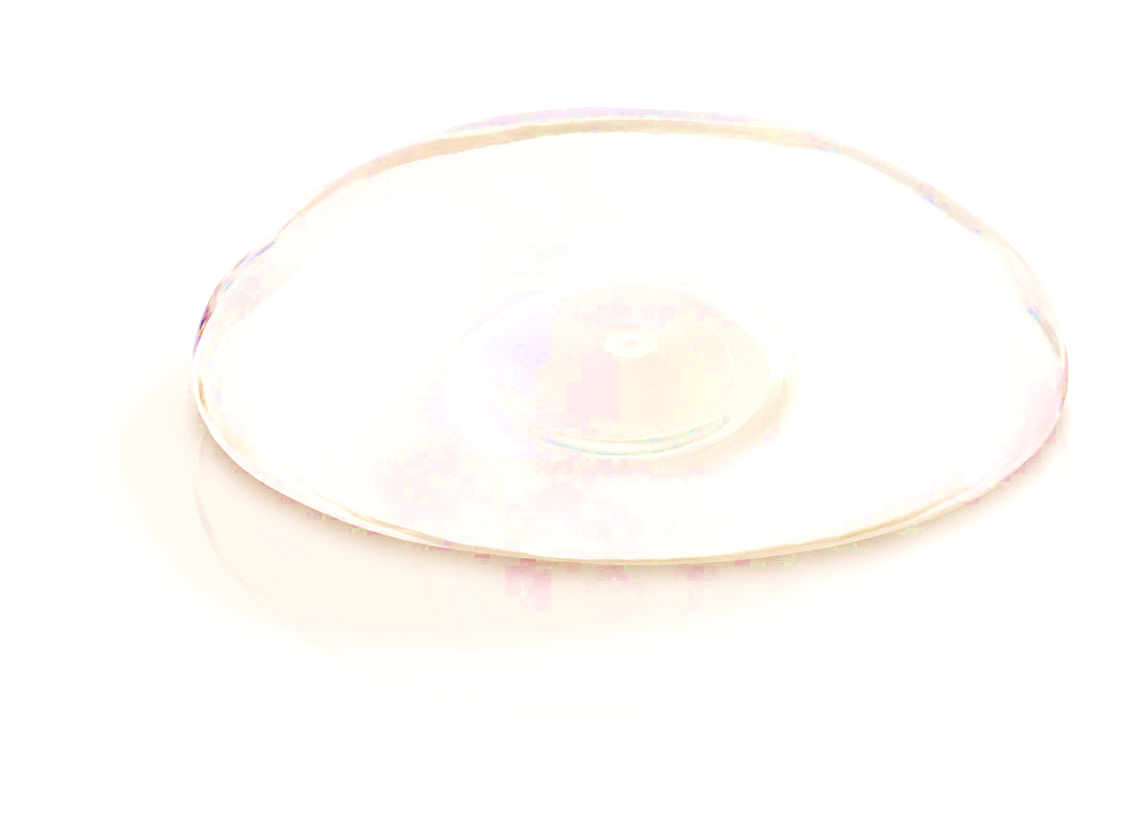
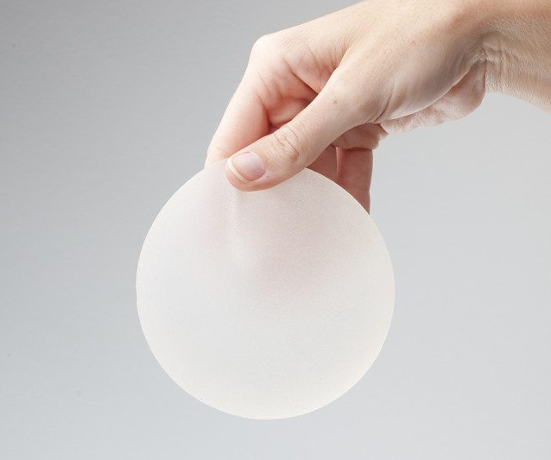

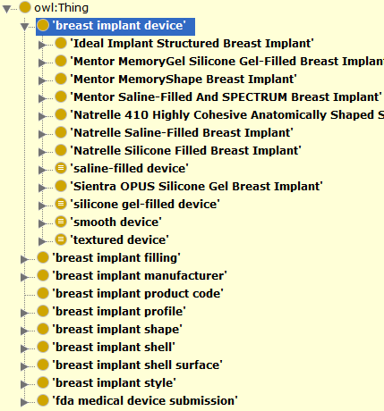
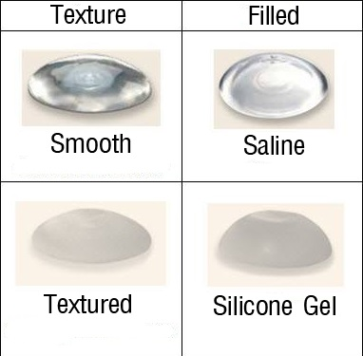
Building a Comprehensive Breast Implant Ontology Leveraging GUDID and Unstructured Data Sources
Mark Jung¹, Michael Wu², Hongying (Helen) Jiang³, Asiyah Yu Lin³, Weiguang Wang³, Zhou Feng³, Dongyi (Tony) Du³, Nilsa Loyo-Berrios³
BACKGROUND
¹Montgomery Blair High School, ²Wheaton High School, ³FDA/CDRH/Office of Surveillance and Biometrics
Individuals with breast implants have a risk of developing breast implant-associated anaplastic large cell lymphoma (BIA-ALCL), which appears to be highly associated with breast implants that have textured surface from the literature. However, both device FDA product codes and Global Medical Device Nomenclature (GMDN) do not provide the terms for breast implants surface type. This significantly hinders the data analysis of the association between the breast implant types and BIA-ALCL. A Breast Implant Ontology can categorize all the breast implant products and their features/attributes under an ontological structure, which can be used by a semantic reasoner tool to automatically classify breast implants features (e.g. smooth or textured surface types). This ontology will also be used as a backend dictionary for a text mining tool to help explore the patterns/trends from BIA-ALCL cases reported in the MDR or other data sources.
Generating the Ontology Sections through Python
CONCLUSIONS AND DISCUSSIONS
Python libraries — including NumPy and Pandas – were used for piping relevant data through various data-capture filters into a compiled Excel file. This will be automated as much as possible to facilitate future GUDID downloads. Protégé, an open source ontology application, was used to help categorize each implant based on their properties to create a logical structure. To increase efficiency, the Python Owlready2 library was used to load all content from the excel sheets into the ontology.
BIO is searchable with SPARQL queries or Protégé’s DL Query tab, allowing users to submit requests for relational classes as well as individual data. This may be used for additional data verification and as a backend dictionary for text-mining for the BIA-ALCL project. BIO will also be released open source to aid other researchers and organizations.
RESULTS
Distribution of Device Characteristics
The Breast Implant Ontology (BIO) classifies 8 FDA approved breast implant lines based on profile, shape, shell, shell surface, fill type, product code, and FDA PMA submission. It also includes annotations of device catalog number, version model number, publish date, GUDID link, PMA link, GMDN name, and GMDN definition.
Device dimensions (not in GUDID), such as width/diameter, height, nominal fill volume, maximum fill volume, nominal projection, and max projection were included in BIO.
OBJECTIVE
The objective of our project is to create an extensive ontology to categorize the different breast implants and their product features, including but not limited to: manufacturer, brand, filling, and so on. The ontology will help FDA determine possible relationships between BI structures and patient symptoms that correspond with BIA-ALCL.
GUDID Data Limitations
METHODS
While GUDID provides a valuable source of data on breast implants, several inconsistencies and complications arise in its use. Medical device manufacturers, who submit device information, may not label and describe their devices the same way as other manufacturers. Additionally, it may not be as up-to-date as actual device information. As such, cross-verification with other sources of information (e.g. company catalogs) were required for validation. GUDID also does not provide specific device dimensions, such as width, height, or projection; relevant information was also extracted from company catalogs.
Breast implant data on implant characteristics were gathered primarily from the Global UDI Database (GUDID) database using the FDA product codes FWM and FTR. Current catalogs from four breast implant sponsors were also used for cross-verification of data as well as providing additional information, such as device dimensions, diameters, heights, projection, etc. Free text such as literature review and research articles were also included.
Figure 2. Protégé’s ontology representation with reasoning. The main class (breast implant device) is expanded to show the 8 FDA approved devices as well as defined classes.
Distribution of Device Characteristics
Total Device Count: 1738
Fill types: 12.4% (216) saline filled, 87.6% (1522) silicone gel filled
Surface types: 47.9% (832) textured surface, 52.1% (906)
ACKNOWLEDGEMENTS
This project is supported by FDA/CDRH OSB lab research module. Authors want to acknowledge the valuable support from [INSERT NAMES HERE]
Figure 1. Two fields of interest to the BIA-ALCL project are the shell surface texture and filling of breast implants.

